Slide 1

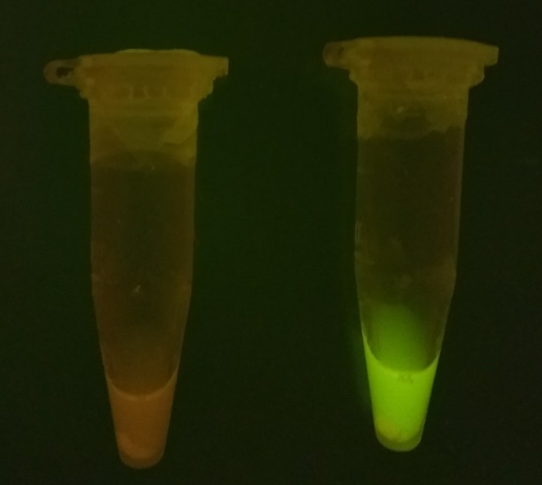
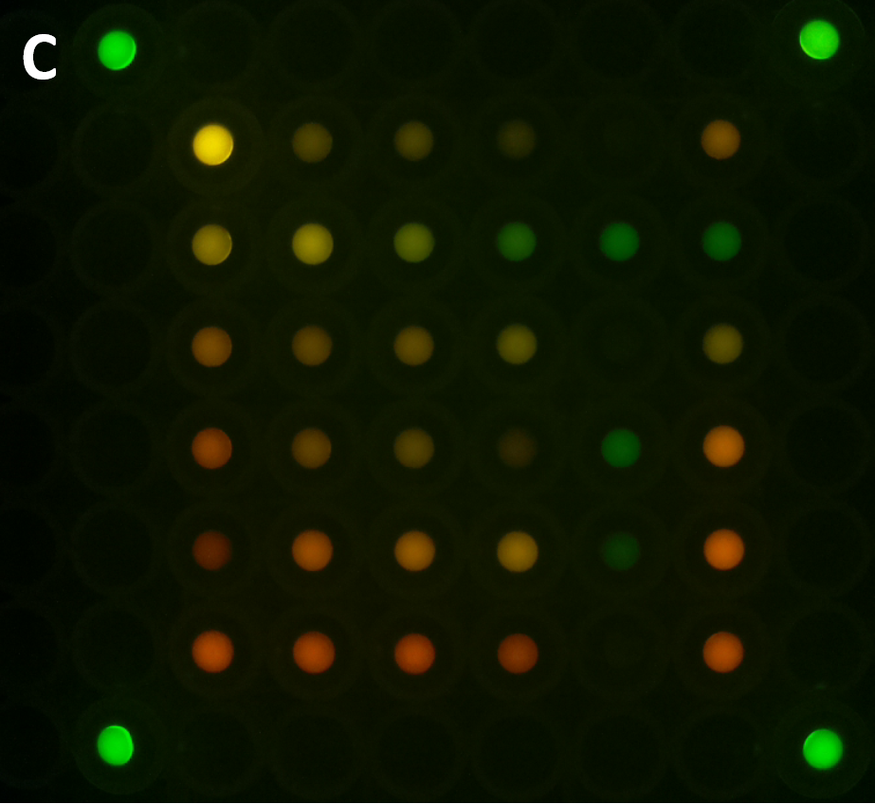
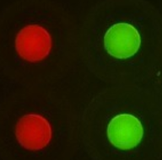
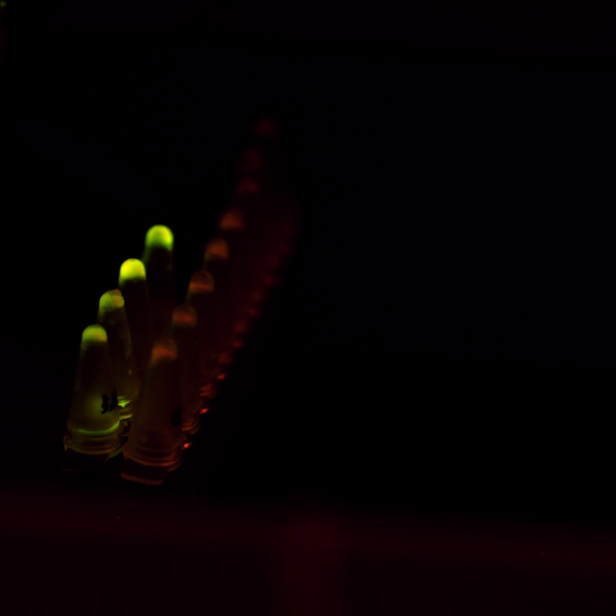
Addressing batch-to-batch variability for robust biosensing purposes using cell-free reactions
Anibal Arce Medina
PhD (c) Molecular Biology and Microbiology
Synthetic biology lab
Notes:
Ejemplo de Newton, mostrar la teoría, mostrar la matemática.

Slide 2
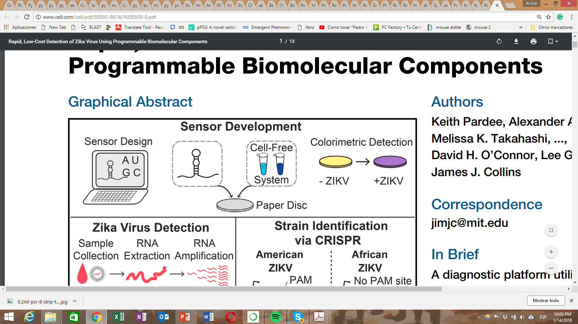

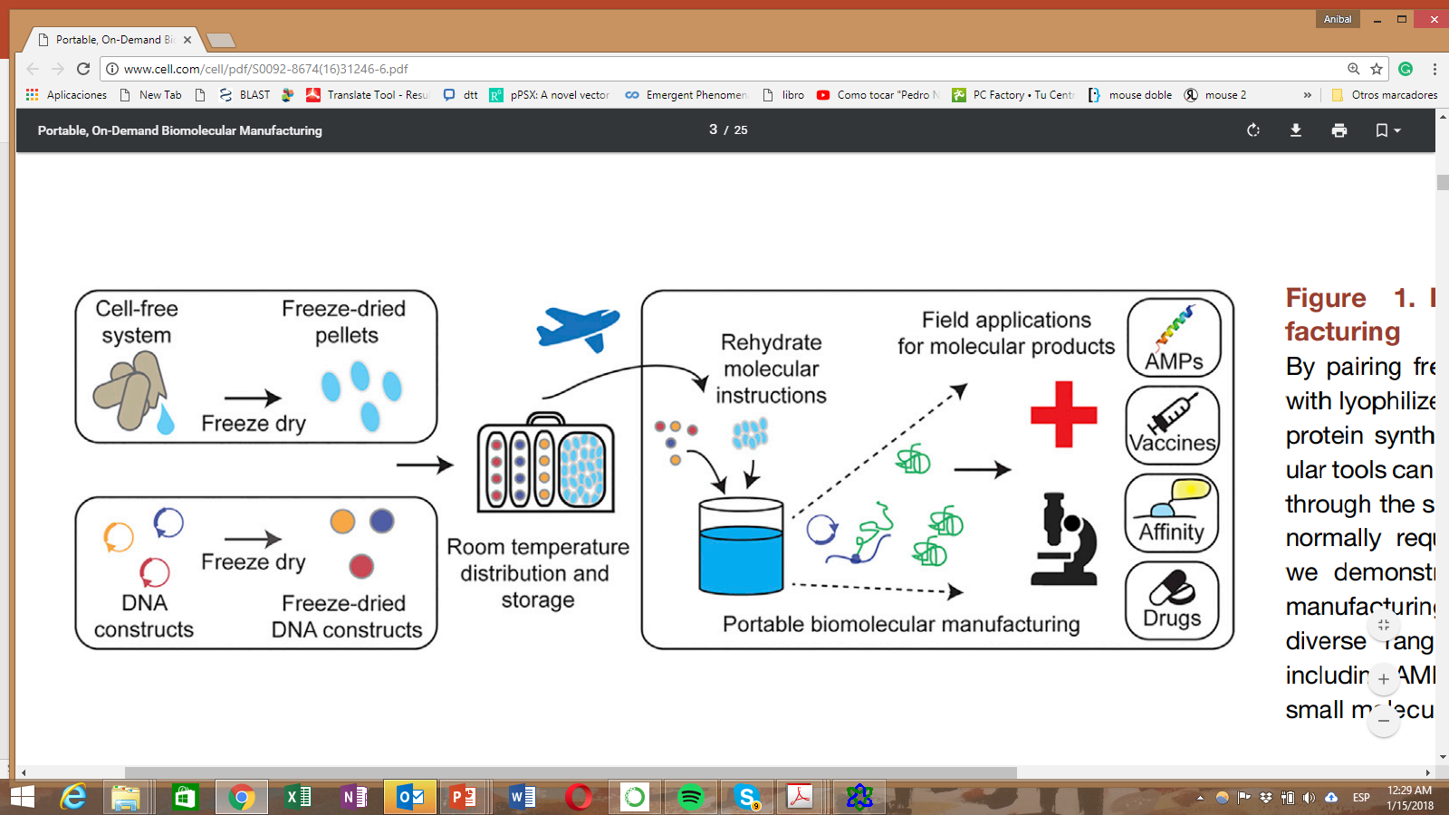
Highlights of cell-free synthetic biology
No need for specialized equipment or refrigeration: Mix and hydrate in situ for field and local necessities
>2 dolars per reaction

Slide 3
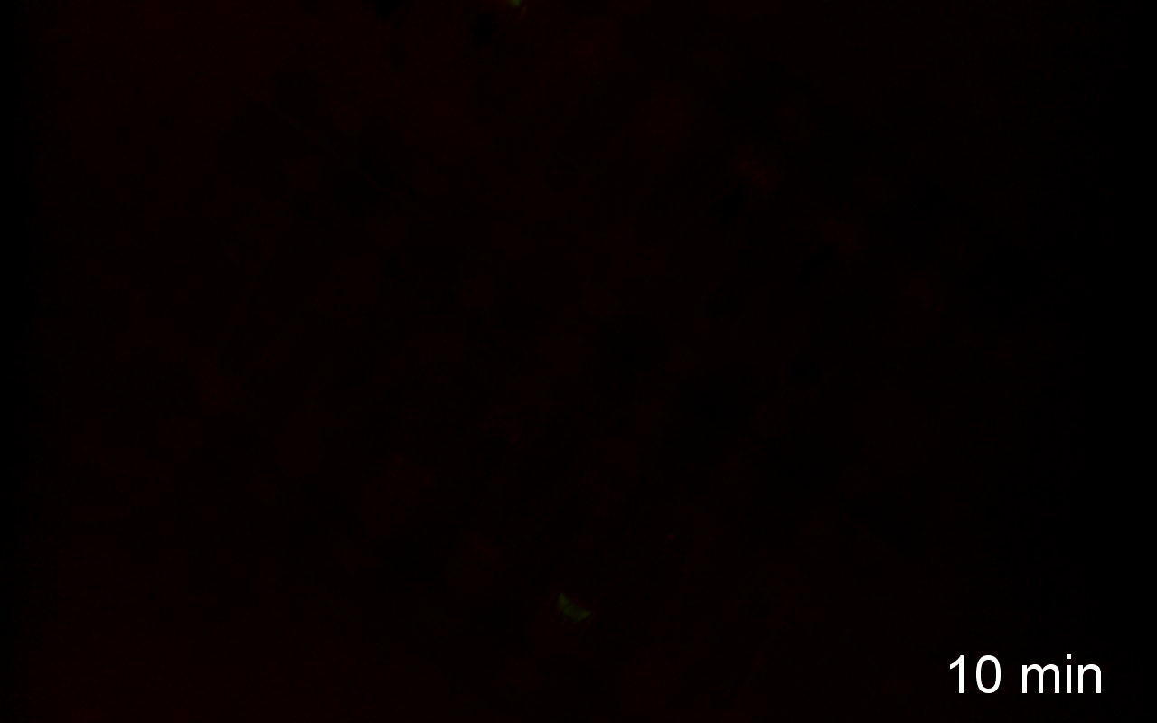
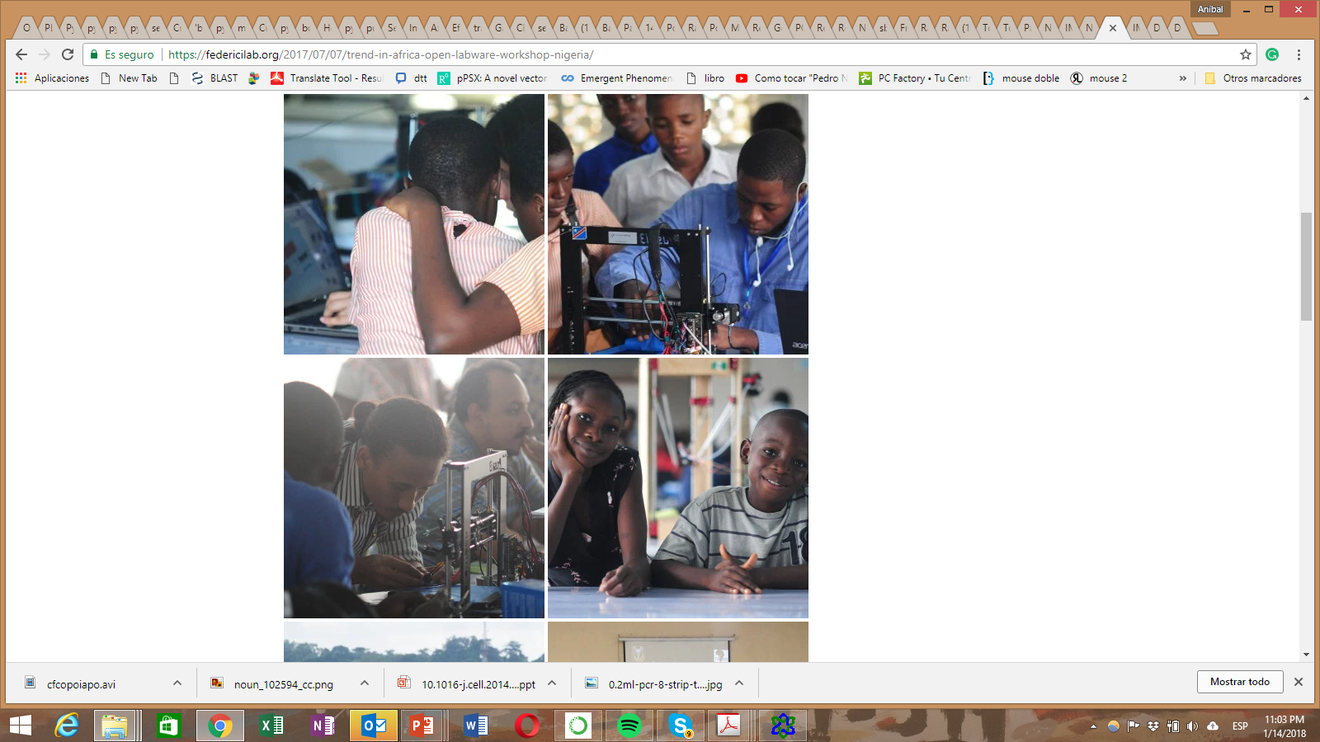
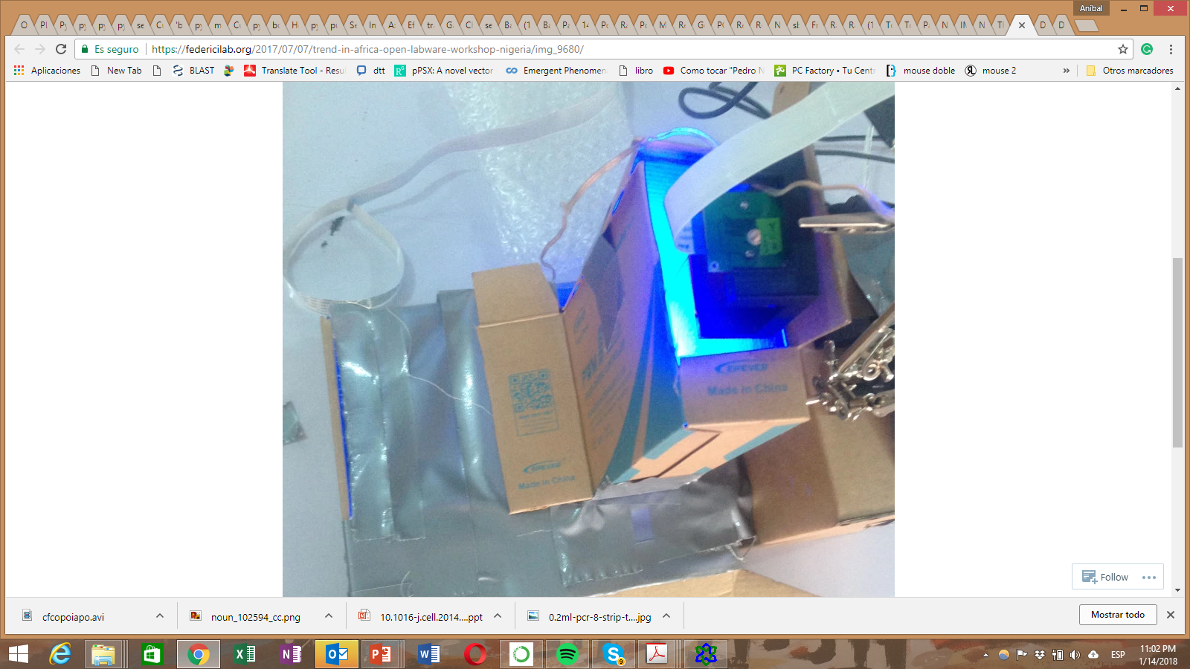
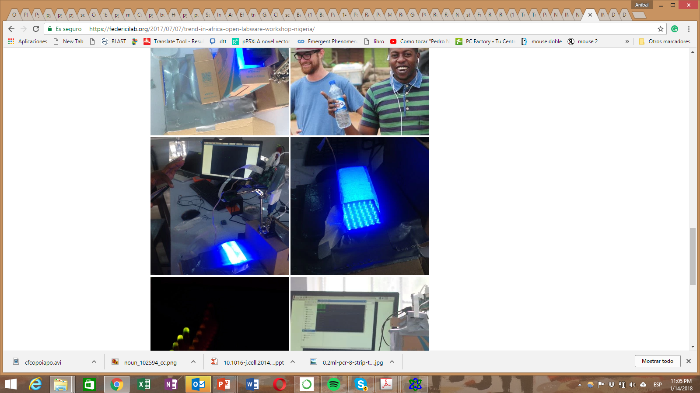
2nd Open labware Workshop at Nigeria
2018

Slide 4
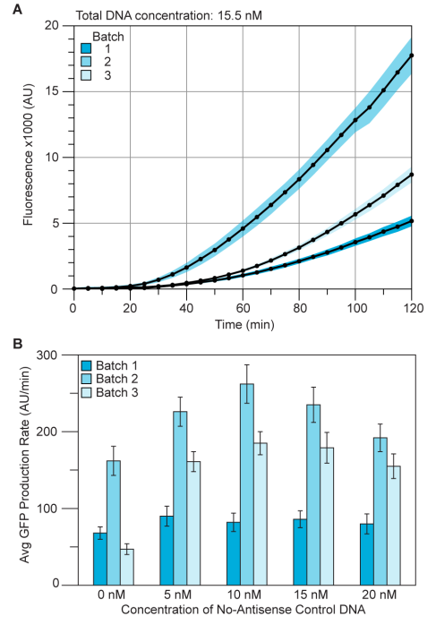
Batch-to-batch variability is a major concern in the field
Important for diagnostics, biosensors and prototyping
Batch-to-batch variability in both end-point expression and in expression dynamics are to be expected (Zachary Sun et al., 2013).
These complex compositions may require standardization of preparation, or individual analysis per batch to understand variability that result extract-to-extract (Takahashi et al., 2015).
Batch variability is an ongoing concern in the field, though experienced cell-free biotechnologists can minimise these effects. (Richard Kelwick in 2017 Plos Blogs ).
If the cell-free expression system is used to conduct sensitive quantitative experiments, it is advisable to run all experiments with the same batch of crude cell extract. (Kate Adamala et al., 2017).
(Takahashi, 2015)

Slide 5
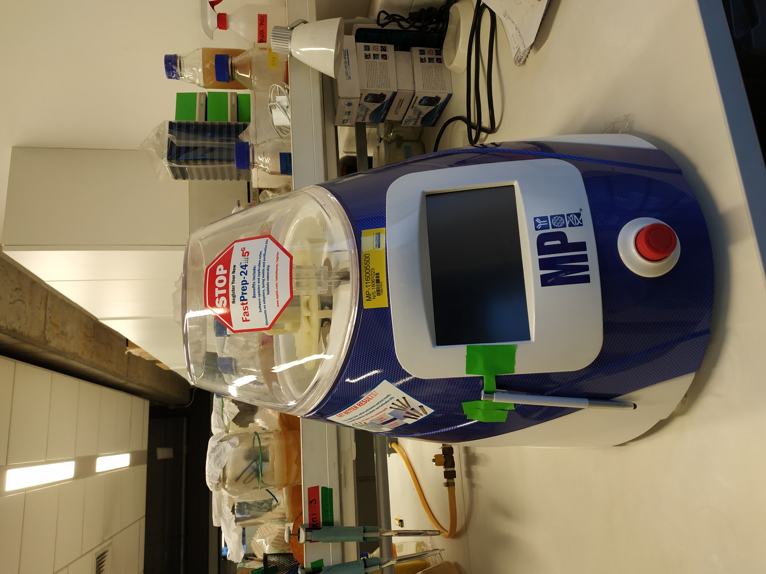
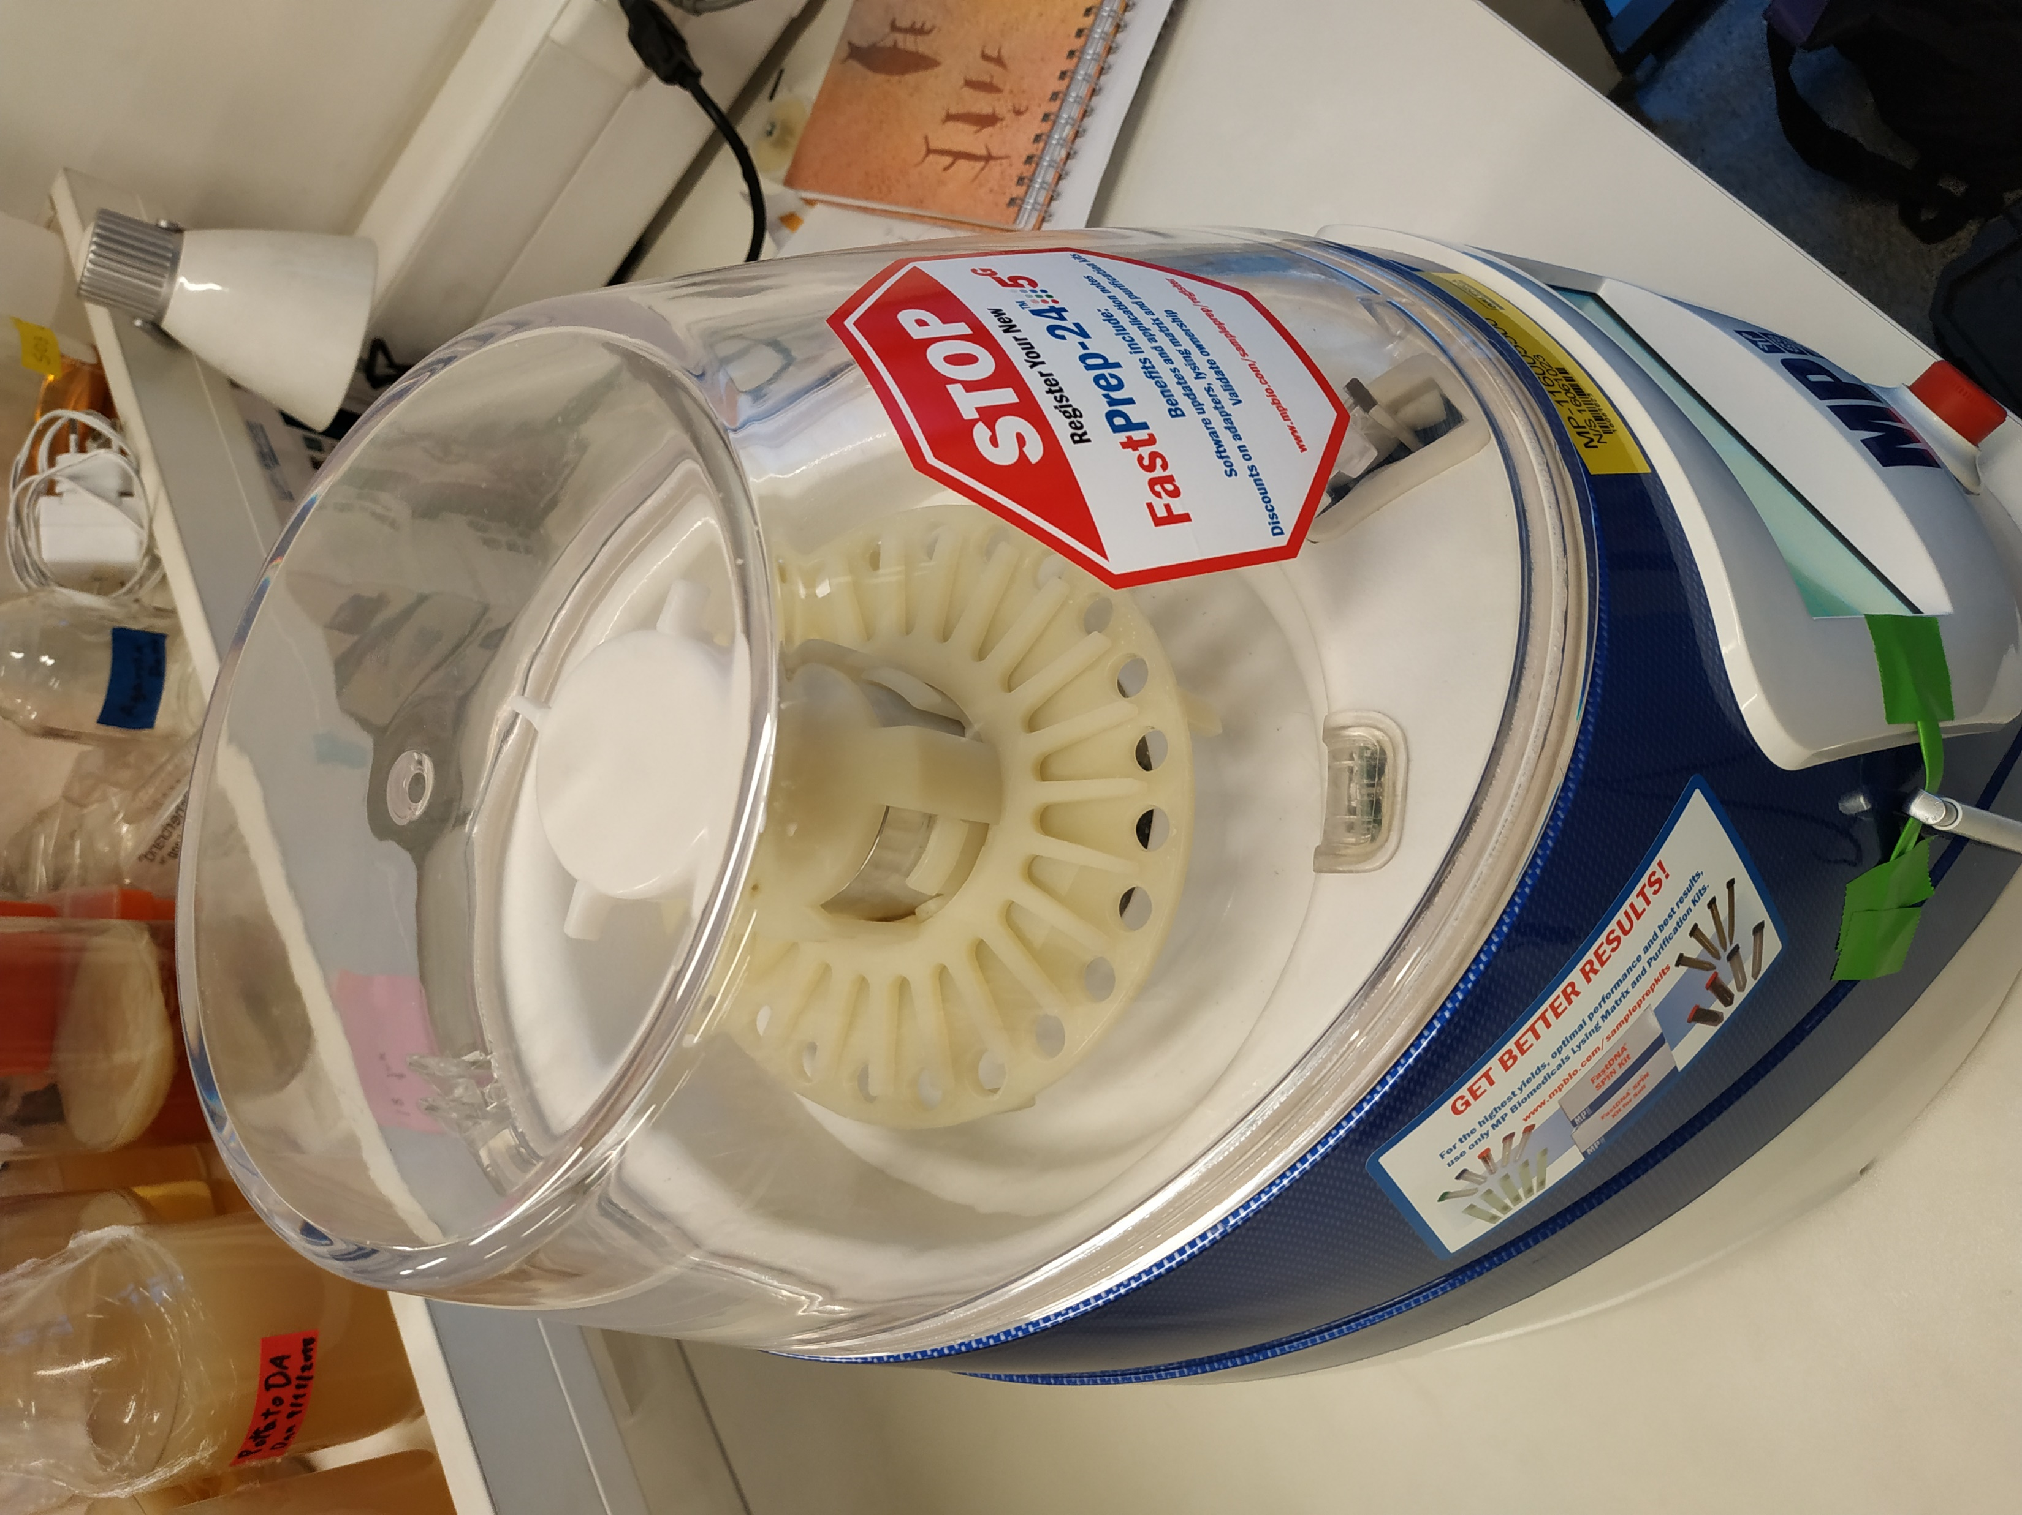
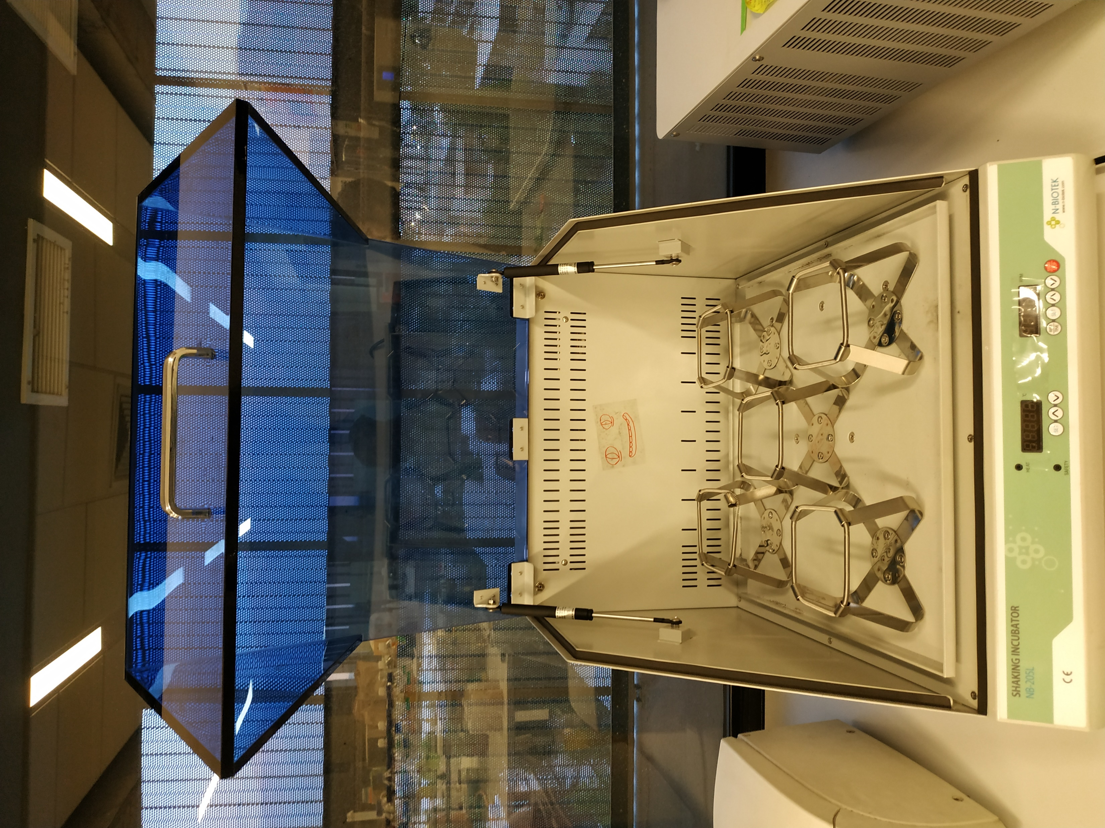
Addressing batch-to-batch variability:
Making several cell extracts

Slide 6
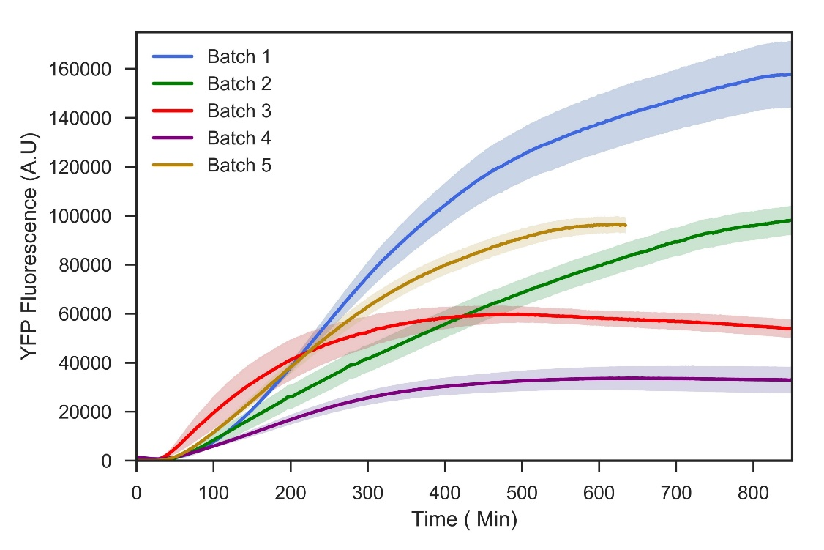
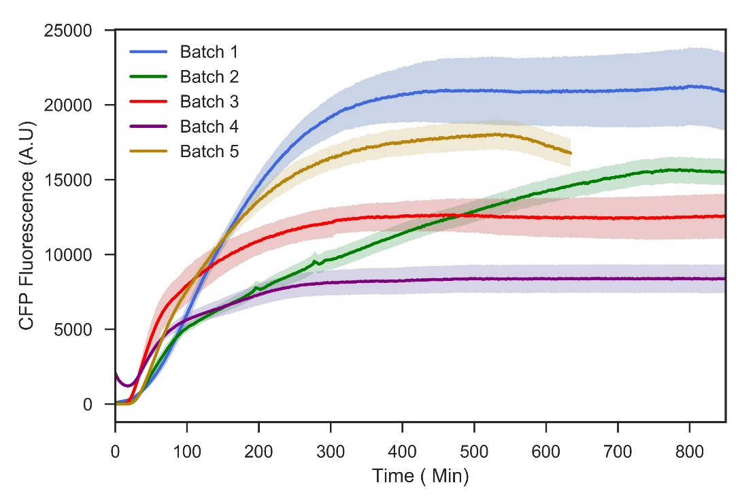
Ratiometric devices to quantify
Batch-to-Batch variability
ProT7
RBS-linker
YFP
TerT7
ProT7
RBS-linker
CFP
TerT7
YFP
CFP
n>7
n>7
Notes:
We want to study this variability and hopefully develop some techniques that help improving our measurenments

Slide 7
Schematic representation of one construct used
ProT7
RBS-linker
YFP
TerT7
ProT7
RBS-linker
CFP
TerT7
ø
δTsR
ø
Device-specific parameters
Batch-specific parameters
δTlR
TsR
TlR
ø
ø
ø
δCFP
δM
δCFP
Kmat C
CFP
mRNA CFP
CFPi
Kts
Ktl
DNA
mRNA YFP
YFPi
Kmat Y
YFP
δM
ø
δYFP
ø
ø
δYFP

Slide 8
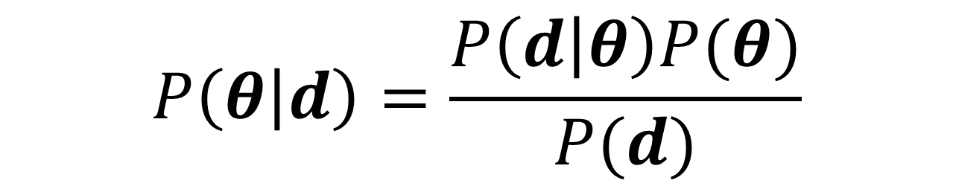
Bayesian statistics are used to infer simultaneously the marginal posterior distributions of all the parameters.
Markov Chain Monte Carlo (MCMC):
Generate samples from a proposal distribution to form a Markov chain
The history of the chain converges to the posterior distribution
$$P\left(θ | d\right)=\frac{P\left(d | θ\right)P(θ)}{P(d)}$$

Slide 9
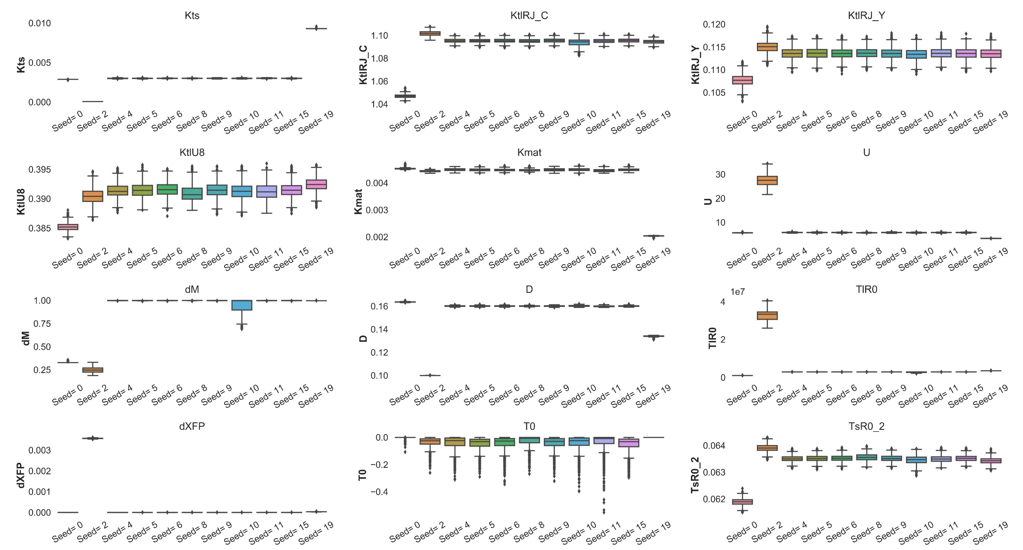
Marginal posterior distributions of the parameters obtained from different seeds

Slide 10
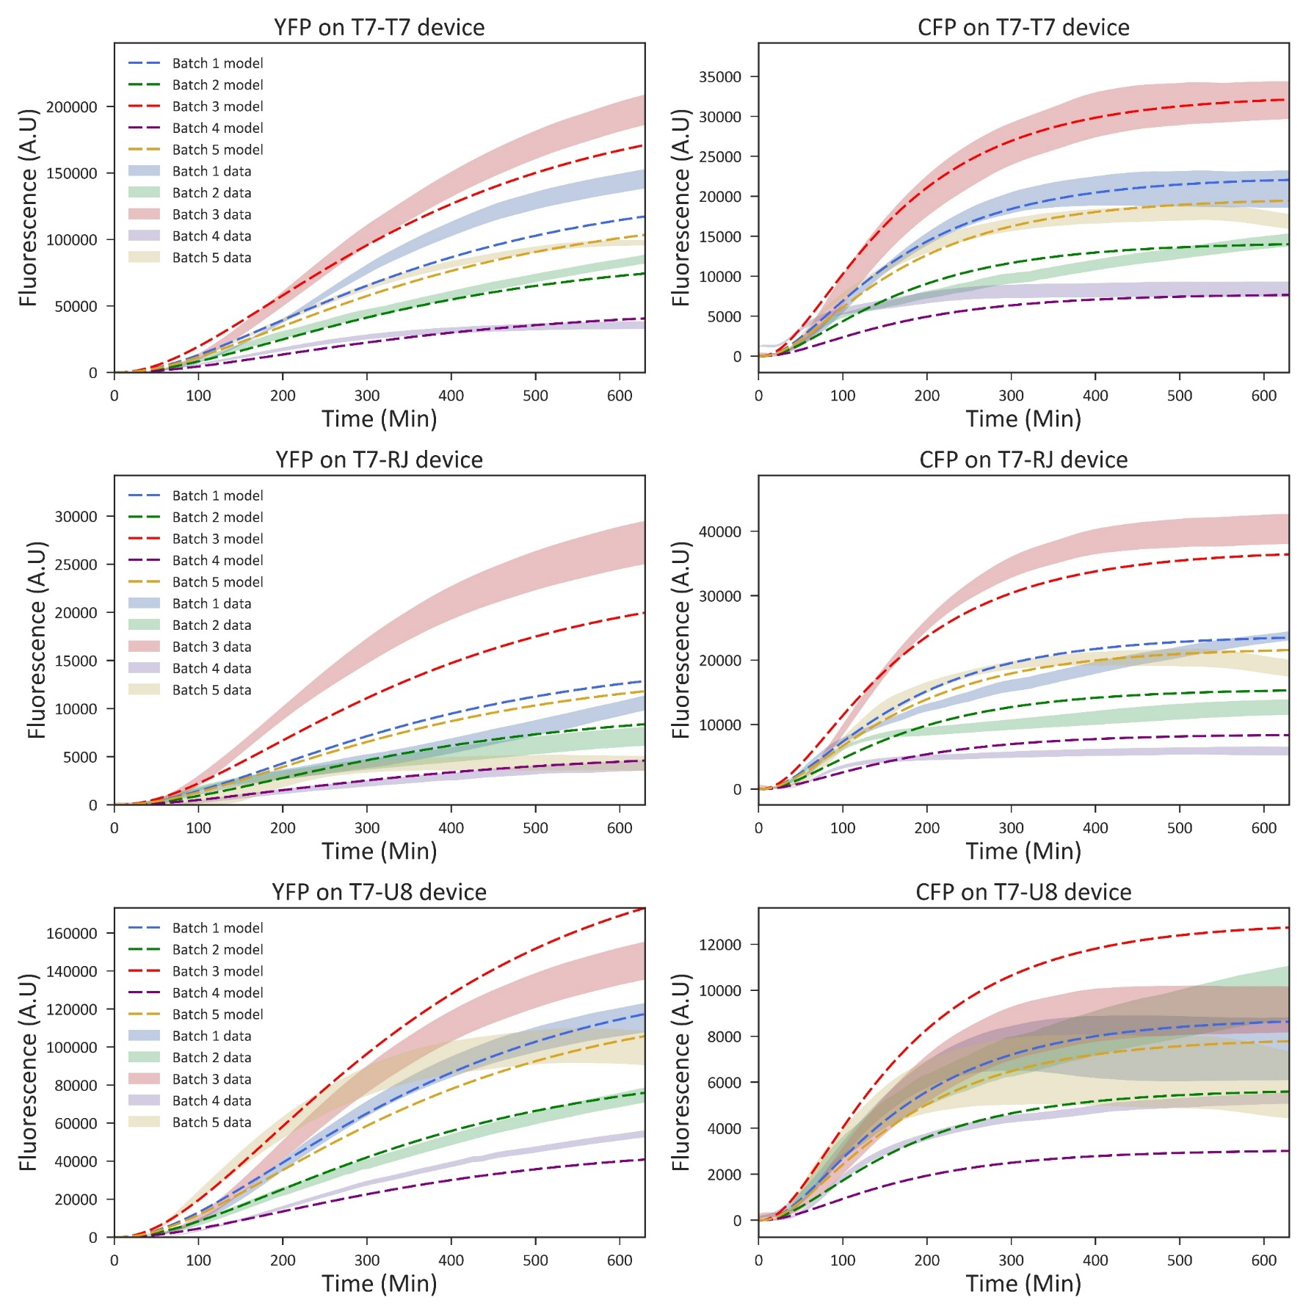
Data v/s model simulations

Slide 11
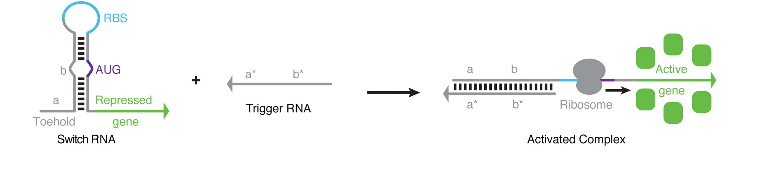
Novel diagnostics using toehold RNA sensors and cell-free biology
Toehold switches detect RNAs with arbitrary sequences
Green et al. Cell (2014)
Notes:
Two independent RNA strands:
Coding región
Hairpin sructuree that hiddes RBS preventing the load of the ribosome.
Toehold domain
SEEDS THE INTERACTION
RNA DISPLACEMENT
INVEDES THE HAIRPING

Slide 12
Ratiometric Sika sensor
ProT7
GFP
ProT7
RBS-linker
mScarlet
Zika Sensor
Batch 1
Batch 2
Batch 3
Batch 4
Batch 5
A.U
30000
20000
10000
5000
2500
1250
21793 | 24108 | 19998 | 7251 | 6096 | 6265 | 20524 | 22671 | 22320 | 4933 | 5622 | 5252 | 14586 | 15001 | 15960
13812 | 21613 | 21597 | 6679 | 6914 | 6840 | 20764 | 20701 | 21947 | 7116 | 9742 | 10603 | 15035 | 17049 | 16558
17905 | 16701 | 15210 | 5848 | 6042 | 5573 | 15826 | 15181 | 15532 | 8482 | 5691 | 5911 | 12905 | 12442 | 12205
12310 | 10562 | 9485 | 4786 | 5147 | 3815 | 9472 | 9436 | 9889 | 5006 | 5615 | 5039 | 9695 | 9536 | 9319
8259 | 8011 | 8050 | 3925 | 3445 | 2700 | 6889 | 7280 | 7192 | 5209 | 4493 | 5153 | 6104 | 2970 | 3558
4662 | 3456 | 4291 | 2939 | 1849 | 1756 | 4178 | 4239 | 3748 | 4769 | 5763 | 5233 | 3098 | 3345 | 2562
Sensor channel
Trigger DNA concentration
A.U
100000
70000
50000
25000
12500
6250
64788 | 78085 | 72809 | 18418 | 14931 | 14391 | 62941 | 64588 | 66217 | 10993 | 14212 | 11792 | 38678 | 36216 | 40877
48571 | 77707 | 81197 | 28340 | 36467 | 27534 | 74068 | 70707 | 78557 | 36661 | 56557 | 56327 | 41533 | 46115 | 41529
93076 | 85542 | 77714 | 32590 | 33600 | 30380 | 75459 | 78018 | 79253 | 43494 | 33030 | 28699 | 49198 | 52551 | 42729
87852 | 65510 | 60650 | 33575 | 41504 | 24922 | 64397 | 70958 | 72941 | 25859 | 29764 | 36725 | 62608 | 50067 | 49552
81354 | 80662 | 65032 | 44436 | 30315 | 23690 | 62870 | 66562 | 67221 | 51500 | 27371 | 48609 | 49215 | 27118 | 29597
88234 | 44712 | 71545 | 43185 | 26356 | 25771 | 66910 | 60872 | 55650 | 67751 | 93182 | 79528 | 46517 | 49612 | 32150
Reference
Trigger DNA concentration
A.U
5
4
3
2
1
0
3.364 | 3.087 | 2.747 | 3.937 | 4.083 | 4.353 | 3.261 | 3.51 | 3.371 | 4.487 | 3.956 | 4.454 | 3.771 | 4.142 | 3.904
2.844 | 2.781 | 2.66 | 2.357 | 1.896 | 2.484 | 2.803 | 2.928 | 2.794 | 1.941 | 1.723 | 1.882 | 3.62 | 3.697 | 3.987
1.924 | 1.952 | 1.957 | 1.794 | 1.798 | 1.834 | 2.097 | 1.946 | 1.96 | 1.95 | 1.723 | 2.06 | 2.623 | 2.368 | 2.856
1.401 | 1.612 | 1.564 | 1.425 | 1.24 | 1.531 | 1.471 | 1.33 | 1.356 | 1.936 | 1.887 | 1.372 | 1.549 | 1.905 | 1.881
1.015 | 0.993 | 1.238 | 0.883 | 1.136 | 1.14 | 1.096 | 1.094 | 1.07 | 1.011 | 1.642 | 1.06 | 1.24 | 1.095 | 1.202
0.528 | 0.773 | 0.6 | 0.681 | 0.702 | 0.681 | 0.624 | 0.696 | 0.673 | 0.704 | 0.618 | 0.658 | 0.666 | 0.674 | 0.797
Ratiometric normalization
Trigger DNA concentration

Slide 13
Ratiometric normalization of a Sika sensor
ProT7
GFP
ProT7
RBS-linker
mScarlet
Zika Sensor
Batch 1
Batch 2
Batch 3
Batch 4
Batch 5
A.U
30000
20000
10000
5000
2500
1250
21793 | 24108 | 19998 | 7251 | 6096 | 6265 | 20524 | 22671 | 22320 | 4933 | 5622 | 5252 | 14586 | 15001 | 15960
13812 | 21613 | 21597 | 6679 | 6914 | 6840 | 20764 | 20701 | 21947 | 7116 | 9742 | 10603 | 15035 | 17049 | 16558
17905 | 16701 | 15210 | 5848 | 6042 | 5573 | 15826 | 15181 | 15532 | 8482 | 5691 | 5911 | 12905 | 12442 | 12205
12310 | 10562 | 9485 | 4786 | 5147 | 3815 | 9472 | 9436 | 9889 | 5006 | 5615 | 5039 | 9695 | 9536 | 9319
8259 | 8011 | 8050 | 3925 | 3445 | 2700 | 6889 | 7280 | 7192 | 5209 | 4493 | 5153 | 6104 | 2970 | 3558
4662 | 3456 | 4291 | 2939 | 1849 | 1756 | 4178 | 4239 | 3748 | 4769 | 5763 | 5233 | 3098 | 3345 | 2562
Sensor channel
Trigger DNA concentration
A.U
100000
70000
50000
25000
12500
6250
64788 | 78085 | 72809 | 18418 | 14931 | 14391 | 62941 | 64588 | 66217 | 10993 | 14212 | 11792 | 38678 | 36216 | 40877
48571 | 77707 | 81197 | 28340 | 36467 | 27534 | 74068 | 70707 | 78557 | 36661 | 56557 | 56327 | 41533 | 46115 | 41529
93076 | 85542 | 77714 | 32590 | 33600 | 30380 | 75459 | 78018 | 79253 | 43494 | 33030 | 28699 | 49198 | 52551 | 42729
87852 | 65510 | 60650 | 33575 | 41504 | 24922 | 64397 | 70958 | 72941 | 25859 | 29764 | 36725 | 62608 | 50067 | 49552
81354 | 80662 | 65032 | 44436 | 30315 | 23690 | 62870 | 66562 | 67221 | 51500 | 27371 | 48609 | 49215 | 27118 | 29597
88234 | 44712 | 71545 | 43185 | 26356 | 25771 | 66910 | 60872 | 55650 | 67751 | 93182 | 79528 | 46517 | 49612 | 32150
Reference
Trigger DNA concentration
A.U
5
4
3
2
1
0
Ratiometric normalization
3.364 | 3.087 | 2.747 | 3.937 | 4.083 | 4.353 | 3.261 | 3.51 | 3.371 | 4.487 | 3.956 | 4.454 | 3.771 | 4.142 | 3.904
2.844 | 2.781 | 2.66 | 2.357 | 1.896 | 2.484 | 2.803 | 2.928 | 2.794 | 1.941 | 1.723 | 1.882 | 3.62 | 3.697 | 3.987
1.924 | 1.952 | 1.957 | 1.794 | 1.798 | 1.834 | 2.097 | 1.946 | 1.96 | 1.95 | 1.723 | 2.06 | 2.623 | 2.368 | 2.856
1.401 | 1.612 | 1.564 | 1.425 | 1.24 | 1.531 | 1.471 | 1.33 | 1.356 | 1.936 | 1.887 | 1.372 | 1.549 | 1.905 | 1.881
1.015 | 0.993 | 1.238 | 0.883 | 1.136 | 1.14 | 1.096 | 1.094 | 1.07 | 1.011 | 1.642 | 1.06 | 1.24 | 1.095 | 1.202
0.528 | 0.773 | 0.6 | 0.681 | 0.702 | 0.681 | 0.624 | 0.696 | 0.673 | 0.704 | 0.618 | 0.658 | 0.666 | 0.674 | 0.797
Trigger DNA concentration

Slide 14
Diluted RNAsin (RNAse inhibitor) improved cell-free reaction performance
End point Fluorescence Intensity (A.U)

Slide 15
Improving expression from linear DNA using CRISPRi
BL21 DE3 STAR
Regualr batches
BL21 DE3 STAR
CRISPRi
RecBCD
GamS expression in the cells

Slide 16
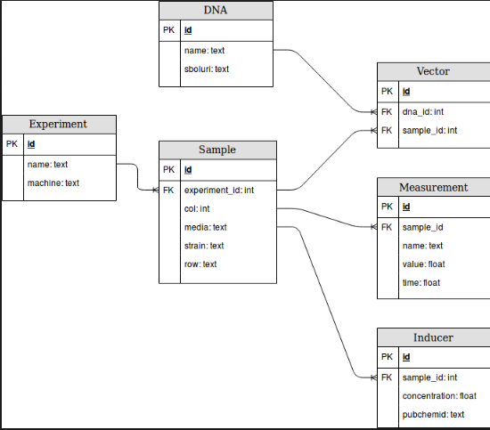
In cell-free we could have different types of DNA:
plasmid DNA
linear DNA from PCR
Concentration is important
Mixtures of several DNAs at different concentrations should be allowed
End-point reactions v/s kinetics
The sample object may consider
Mixtures of different DNAs at different concentrations
Composition and concentration of reagents is important:
( 30% cell-extract v/s 50% cell-extract;
´+/- Inhibitor (at some concentrations )
Different reaction volumes
Mixtures of cell-extracts ( alpha complementation )
New Objects
Cell-extract:
Oganism_id text
Strain_id text
Batch: id
Lyophilization: text
(Bradford) Protein concentration: float
Oher parameters
Rxn Buffer:
Energy source: text (glucose, Mdx, 3pga, …)
Composition

Slide 17
Addressing batch-to-batch variability for robust biosensing purposes using cell-free reactions
Anibal Arce Medina
PhD (c) Molecular Biology and Microbiology
Synthetic biology lab
Notes:
Ejemplo de Newton, mostrar la teoría, mostrar la matemática.

